Slide 1
Unlearn what you have learned about the LMS
Stijn Dekeyser
Penny de Byl
Michael de Raadt

Slide 2
What is an LMS
Learning Management System
Aka Virtual Learning environment
Is a software package
  enables the management and delivery of learning content and resources to students.
Mostly web-based to facilitate "anytime, anywhere" access
  Web Server + server-side scripting
  Database back-end (usually relational)
  Client browser [+ scripts/applets]

Slide 3
EduCause ECAR Study
Source: Educause Study (www.educause.edu/ecar) 2003
Key Findings (1/3)
  Technology Challenge for Students
    Additional training often necessary
  Lack of Control for Faculty
    “[LMSs] constrain you through idiocy. The inflexibility of the structure gets in the way of good pedagogy.” – Prof A. Zarinia, UW
  Lack of Measurement Tools
    LMS reports and stats insufficient
  LMS as Management Tool
    Evidence that LMS increases interaction between faculty and students
    But primarily used by staff to facilitate quiz/assignment administration
    Changes focus from ‘pedagogical’ to ‘administrative’ tool

Slide 4
EduCause ECAR Study
Source: Educause Study (www.educause.edu/ecar) 2003
Key Findings (2/3)
  Managing Change is Essential
    Reluctance to use LMS because of constant change
    Technical setup easier than socialization
  Training of Staff
    Training of staff is essential and should be as close to faculty as possible, on a small scale and including realistic examples
  LMS effect on pedagogy
    Impact perceived but difficult to measure
    Invites staff to rethink course material
    Better organization, increasing engagement
    Gradebook increases transparency and accountability
    Increased amount of discussion, interaction

Slide 5
EduCause ECAR Study
Source: Educause Study (www.educause.edu/ecar) 2003
Key Findings (3/3)
  Satisfaction with LMS features
    Faculty use limited LMS functionality
    Express dissatisfaction with some features
    Static, admin tools most used
      Storing syllabi
      Making announcements
      Course administration
    Gradebook, assessment, discussion tools used often but dissatisfaction

Slide 6
Features
Source: http://www.edutools.info/compare.jsp?pj=8&i=263,276,299,358,366,386,387
Learner Tools
  Communication Tools
    Discussion Forums
    File Exchange
    Internal Email
    Online Journal/Notes
    Real-time Chat
    Video Services
    Whiteboard
  Productivity Tools
    Bookmarks
    Orientation/Help
    Searching Within Course
    Calendar/Progress Review
    Work Offline/Synchronize
  Student Involvement Tools
    Groupwork
    Self-assessment
    Student Community Building
    Student Portfolios

Slide 7
Features
Comparison: http://www.edutools.info/compare.jsp?pj=8&i=276,358,392
Support Tools
  Administration Tools
    Authentication
    Course Authorization
    Registration Integration
    Hosted Services
  Course Delivery Tools
    Course Management
    Instructor Helpdesk
    Online Grading Tools
    Student Tracking
    Automated Testing and Scoring
  Curriculum Design
    Accessibility Compliance
    Course Templates
    Curriculum Management
    Customized Look and Feel
    Instructional Standards Compliance
    Instructional Design Tools
    Content Sharing/Reuse

Slide 8
Technical Issues
Data management
  Usually Relational Database
    Oracle or SQLServer » PostgreSQL » MySQL » text files
    Preferably choice can be changed
  Uploaded files should be managed by OS, not database
  Database schema should be extensible to cater for USQ particularities

Slide 9
Technical Issues
Modularization
  Extensibility
Distribution
Integration
  Use of web services to integrate LMS with USQ databases
Server-side scripting vs client
Conformance to standards
  Web standards
  Accessibility standards
  E-learning standards

Slide 10
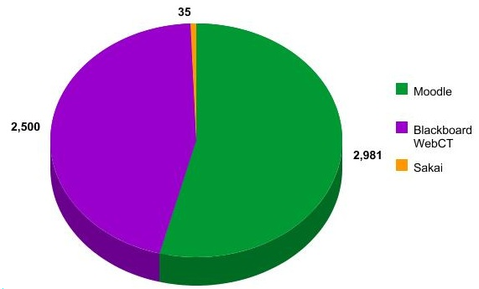
Penetration
Source: Zacker.org
Notes:
  margin of error for Moodle ≈10%
    Plus: test implementations
    Minus: unreported installations
  Excludes secondary, primary levels
45%
54%

Slide 11
Innovation
Source: learningcircuits.org
“Are Open Source LMS platforms taking the lead in learning technology innovation?”
  YES
  “Compare Moodle with [commercial systems] Moodle has the majority of features the big proprietary LMSs have. […] of 42 LMS features and capabilities, Moodle had all but eight.”
  – Richard Brincefield, CEO of GlobalLiteracy Inc.
  YES
  “I believe that the answer to the innovation question is clear, and addressed more by the fact that projects like Sakai and OSPI are developed by a ‘community’ than the fact that it’s Open Source. ”
  – Patrick F. Carey, leader, Americas Higher Education Industry, IBM

Slide 12
Associated Standards
IMS Global
  non-profit standards organization
  concerned with establishing interoperability for learning systems and learning content
  mission is to "support the adoption and use of learning technology worldwide".
SCORM
  Sharable Content Object Reference Model
  A collection of standards and specifications for web-based e-learning
  Defines communications between client side content and a host system called the run-time environment
  Also defines how content may be packaged into a transferrable ZIP file.
eLML
  The eLesson Markup Language (eLML)
  Is an open source XML framework for creating eLessons using XML
  The didactical fundament of eLML is the pedagogical model called ECLASS

